Slide 1



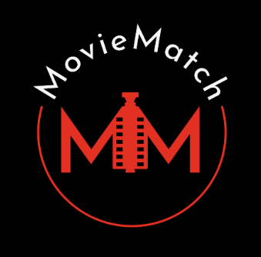


ALBERT – generate embeddings
Azure Cognitive Services – Speecht to text
Azure Cosmos Database
F
E
D
Mock Option
5 – turn voice recording into text
4 – read databse
6 – turn text into embedding
MovieMatch
Middleware
Watcher
2 – recommendation by voice recording
3 – check balance
1 – recommendation by ids
B
C
A

